Slide 1
Crash Course
Color Theory

Slide 2

OK GO!

Slide 3
Color Theory Basics

Slide 4
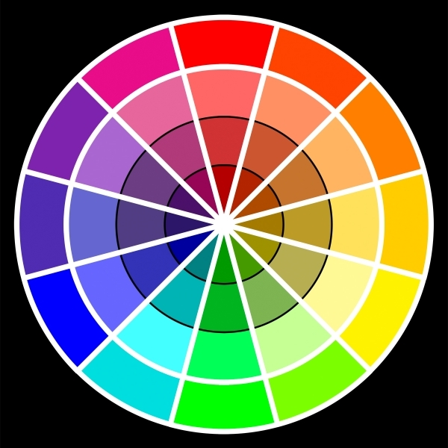
Basic Vocabulary
Primary
  Colors that cannot be made by mixing other colors
  Red, Yellow, Blue

Slide 5
Basic Vocabulary
Secondary
  Colors made by mixing two primary colors
  Orange, Green, Purple

Slide 6
Basic Vocabulary
Tertiary
  Colors made by mixing a primary and secondary color
  Red Orange, Blue Green, etc

Slide 7
Basic Vocabulary
Tint
  A color + white
Shade
  A color + black
Monochromatic
  Art made using only tints and shades of one color

Slide 8
Basic Vocabulary
Analogous
  Colors next to each other on the color wheel
  Ex: orange, yellow, green

Slide 9
Basic Vocabulary
Complementary
  Colors across the color wheel from each other

Slide 10
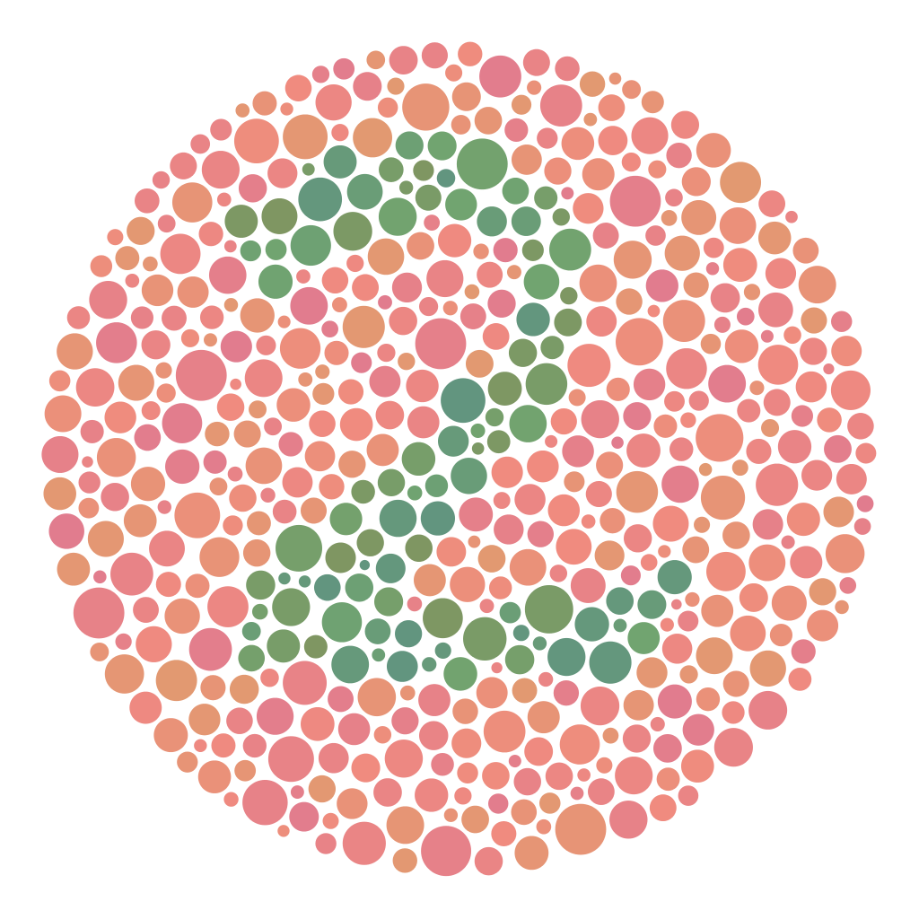
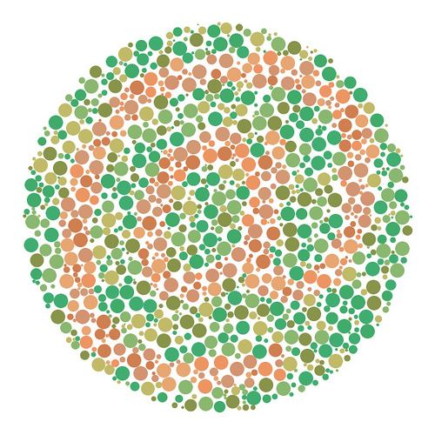
Colorblindness

Slide 11
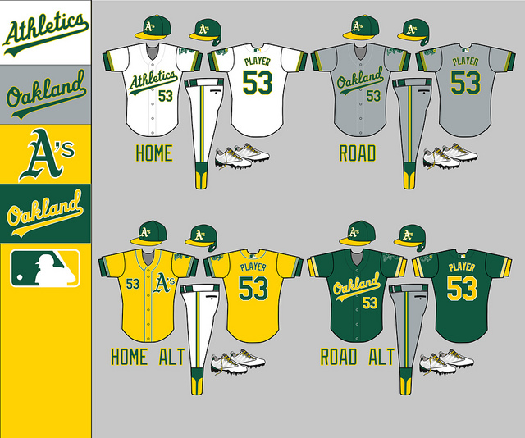
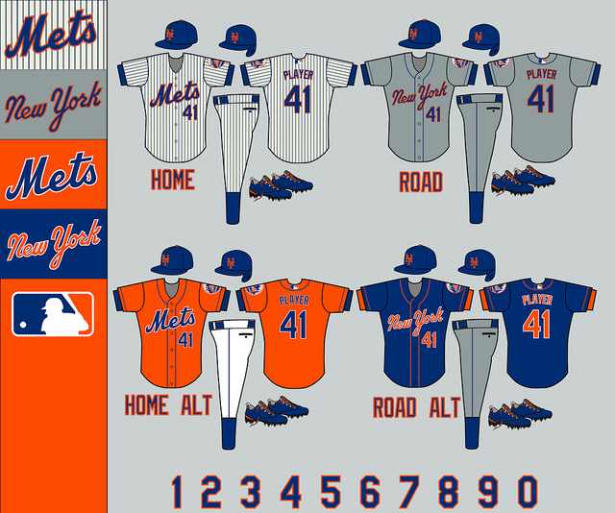
Sports

Slide 12
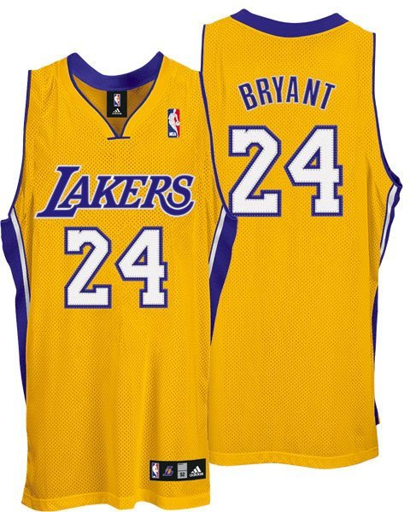
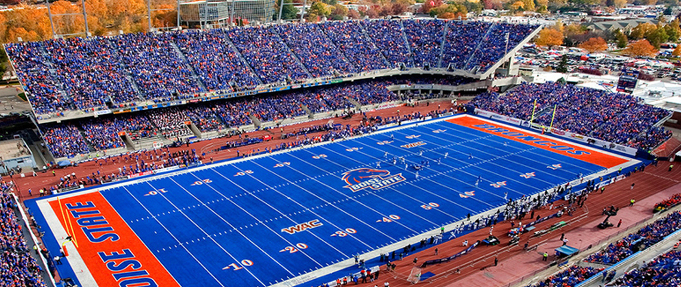
Sports

Slide 13
Basic Vocabulary
Warm
  Red, Orange, Yellow
Cool
  Green, Blue, Purple

Slide 14
The Effects Of Color

Slide 15
Put Into Practice
Colored Pencil Color Wheel-Completed by FRIDAY
Color Wheel “Mosaic”-Completed by WEDNESDAY

